Slide 1
International Finance
20
Notes:
Pre-class music: “I Think I’m Gonna Like It Here” by Elvis Presley (See Tip #673)
In this song, the King of Rock and Roll takes a trip down to Mexico and marvels at all the fun and beauty the country has to offer. Elvis clearly has a demand for the goods and services offered by this Mexican town he’s in; therefore, he must exchange U.S. currency for the local currency, the peso, which he spends almost immediately.
This song is a nice introduction to the characteristics of the foreign exchange market.

Slide 2
Previously
U.S. imports and exports are higher than previous generations.
Trade creates value when countries specialize in producing goods in which they have a comparative advantage.
Barriers to trade exist for various political and economic reasons, but barriers are eroding worldwide.

Slide 3
Big Questions
Why do exchange rates rise and fall?
What is purchasing power parity?
What causes trade deficits?

Slide 4
Why Do Exchange Rates Rise and Fall?—1
Exchange rates
  Price of foreign currency
  Amount of dollars required to buy units of another currency
Why do exchange rates matter?
  To buy foreign goods, you need foreign currency.
  The price you pay in America for a good made in Mexico depends on the exchange rate between the dollar and peso.
  Exchange rates affect import and export prices, and therefore GDP.
Notes:
Lecture notes:
An example:
The price you pay in America for a Samsung television built in South Korea depends on the exchange rate between the U.S. dollar and the won (the currency of South Korea).
Zooming out to the macro view, this means exchange rates affect the prices of all imports and exports, and therefore GDP.
The more integrated the world economy, the more closely we watch exchange rates since they affect both what we produce and what we consume.

Slide 5
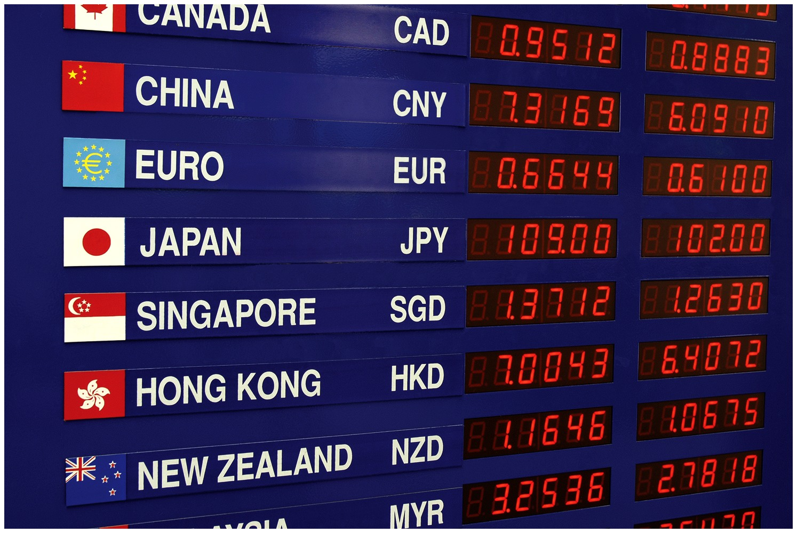
Why Do Exchange Rates
Rise and Fall?—2
Exchange rates are prices
  Prices are determined in markets
  Foreign exchange markets: markets where people buy and sell currencies
How are these prices determined?
  Just like other markets, supply and demand in foreign exchange markets determine prices (exchange rates)
Notes:
Lecture tip:
Make sure to emphasize that the key message in this chapter is: Exchange rates are prices.
These prices are determined in world currency markets.
Lecture notes:
The exchange rate is a price that tells you how much a unit of foreign currency costs you in terms of another currency.
For example, the price of a single Mexican peso in terms of U.S. dollars is about $0.08, or eight cents.
This is the exchange rate between the peso and the dollar.
Regarding the image on the slide: The board shows prices of foreign currencies.
How many dollars does it take to buy a euro? Exchange rates are prices of currencies.

Slide 6
Economics in Parks and Recreation, “London”
Foreign currency
Notes:
“Economics in the Media” Slide
Lecture tip:
The clip mentioned on the slide can be found in the Interactive Instructor’s Guide. Access the direct link by clicking the icon in the PowerPoint above.
This could be a good clip to show students to introduce concepts of foreign currency and exchange rates.

Slide 7
Characteristics of Foreign Currency Markets
Derived demand
  Demand for a good or service that derives from the demand for a separate good or service
The derived demand for foreign currency:
  We don’t “directly” demand or consume foreign currency.
  We demand certain amounts of foreign goods and the needed amount of foreign currency.
  Credit/debit cards make foreign purchases easy, but banks charge fees for the currency exchanges.
Notes:
Lecture notes:
We don’t directly demand currencies (unless we are currency speculators in the market, but that doesn’t apply to most people).
That is, we don’t say “I would like to buy 10 euros today.”
We instead look at goods in Europe, and say “I would like to buy some French perfume today.”
We only want foreign currency to use it as a means to purchase other goods.
We then exchange dollars for euros, and use the euros to buy the French perfume.
The amount of foreign currency demand is derived from the amount of foreign goods we demand.
We need to use the foreign currency to pay for the foreign goods.

Slide 8
Exchange Rates—1
The exchange rate is the price of foreign currency.
Multiple ways to view the price:
  Number of euros you can buy with one dollar (€ per $)
  Number of dollars required to buy one euro ($ per €)
These two methods will yield reciprocal numbers.
  There is no “standard” way to state exchange rates.
  We will use the second method since this is how we think of other goods (how many dollars needed to buy).
Notes:
Lecture notes:
While these methods communicate the same information, they are not the same price, and in fact they are reciprocals.
We choose the second option because it is the way we quote all other prices.
If you walk into Starbucks and look at the prices posted on the wall, they are the number of dollars it takes to buy different coffee drinks, rather than the number of coffee drinks you can get for $1.
So when we refer to exchange rates, we’re always talking about the number of dollars required to buy one unit of foreign currency.
Think about going into a store and asking “How much for a euro?” They’ll tell you how many dollars it takes to buy one euro.
Unfortunately, there is no single convention in exchange rate reporting by most financial news media.
In fact, if you decide to look up exchange rates on the Internet, any single table probably quotes both variations.

Slide 9
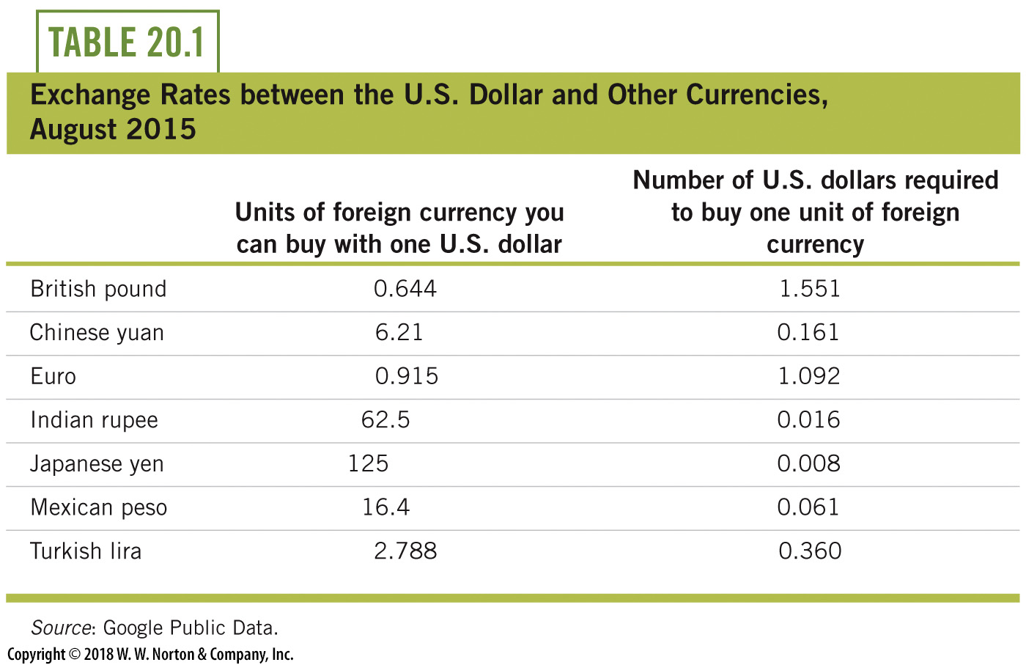
Exchange Rates, August 2015
Notes:
Lecture tip:
We read the right column of the table as:
It takes 1.092 dollars to buy a euro.
It takes 1.551 dollars to buy a British pound.

Slide 10
Exchange Rates—2
Currency appreciation
  A currency increases in value relative to other currencies
  Dollar appreciation means:
    You can buy more euros with a dollar
    It takes fewer dollars to buy a euro
Currency depreciation
  A currency increases in value relative to other currencies
  Dollar depreciation means that:
    You can buy fewer euros with a dollar
    It takes more dollars to buy a euro
Notes:
Lecture notes:
If you are an American with dollars and want to buy foreign goods, you like it if the dollar appreciates.
That way, you could use the same dollars to buy more foreign currencies (and more foreign goods).
If the dollar depreciates, your dollar won’t buy as many foreign currencies (or foreign goods).

Slide 11
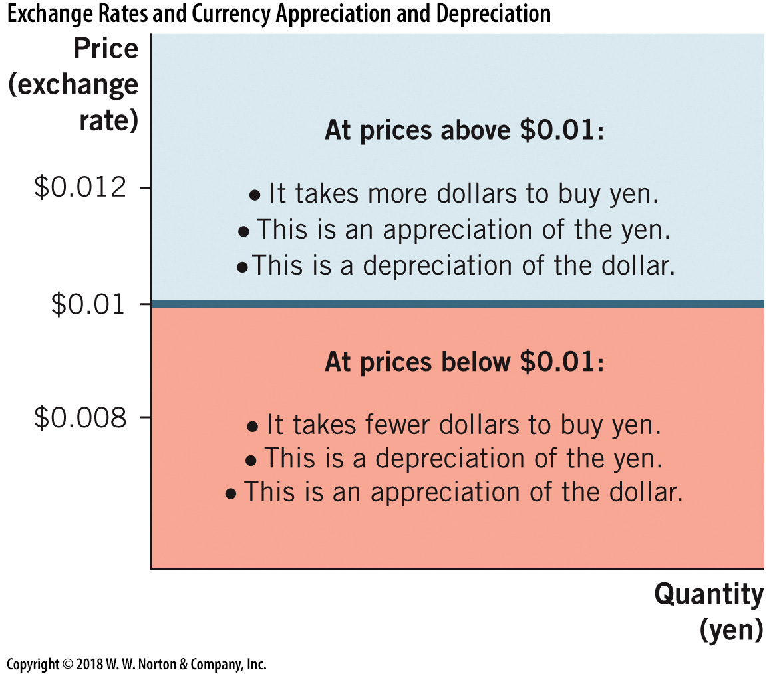
Appreciation and Depreciation
Notes:
Image: Figure 20.1
Lecture notes:
The figure on the slide shows appreciation and depreciation with the exchange rate between the U.S. dollar and the yen.
The exchange rate starts at $0.01.
If the exchange rate rises above $0.01:
takes more dollars to buy a yen
appreciation of the yen
depreciation of the dollar
If, instead, the price falls below $0.01:
takes fewer dollars to buy a yen
depreciation of the yen
appreciation of the dollar

Slide 12
Economics in “McDonald’s Falling Dollar Commercial”
Value of a dollar
Notes:
“Economics in the Media” Slide
Lecture tip:
The clip mentioned on the slide can be found in the Interactive Instructor’s Guide. Access the direct link by clicking the icon in the PowerPoint above.
This commercial is a good introduction to what is meant by statements like “the dollar is weak” or “the dollar is falling”–phrases that your students are likely to have heard in the news over their lifetimes.

Slide 13
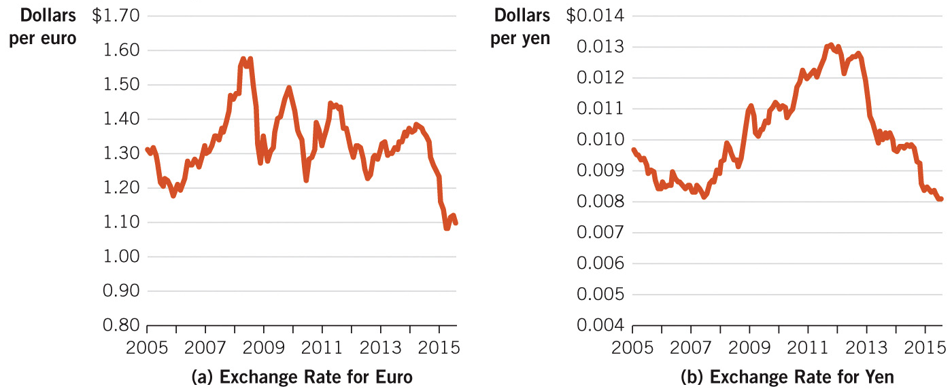
Exchange Rates: Historical Perspective
Notes:
Image: Figure 20.2
Lecture notes:
These exchange rates in this figure are reported as the number of U.S. dollars per unit of foreign currency.
The price of the euro rose from $1.30 to $1.60 during recession of 2008.
Recently, it fell back to $1.10.
The Japanese yen became more expensive from 2007 to 2013.
This made Japanese goods more expensive to Americans.
The price fell dramatically after 2013.
When the exchange rates rise, this indicates more dollars are required for a unit of currency.
Thus, a rise in the exchange rate is a depreciation of the U.S. dollar (conversely, a decline of the exchange rate is an appreciation of the foreign currency).

Slide 14
Practice What You Know—1
Exchange rates can be thought of as:
  the demand for foreign currency.
  the price of foreign currency.
  the price of imports.
  the quantity of goods exchanged across borders.
Notes:
Clicker question:
Correct answer: B, the price of foreign currency.
Exchange rates: The price of foreign currency; in other words, the amount of dollars required to buy units of another currency.
For example, Mexican pesos.

Slide 15
Demand for Foreign Currency—1
If exchange rates rise:
  Foreign currencies become more expensive
  Imports become more expensive
  U.S. exports are cheaper for other countries to buy
Factors that affect the demand side of the market for foreign currency:
  The exchange rate (price) of the currency (movement)
  Demand for foreign goods and services (shift)
  Demand for foreign financial assets (shift)
Notes:
Lecture notes:
“Exchange rates rise…”
What does that mean?
With our notation, if exchange rates rise, it means it takes more dollars to buy foreign currencies.
Instead of paying a low price, we have to pay a higher dollar price for foreign currency.
Rising exchange rates could be caused by the dollar depreciating or the foreign currency appreciating.
Recall: “Movement” means moving along the demand curve, from one point to another; a change in quantity demanded.
“Shift” means the whole demand curve changes locations (shifts right or left); an increase or decrease in demand.
If the price of euros falls, the quantity demanded increases.
If the price of euros rises, quantity demanded falls, since purchasing European goods is more expensive.
The law of demand holds in foreign currency markets.

Slide 16
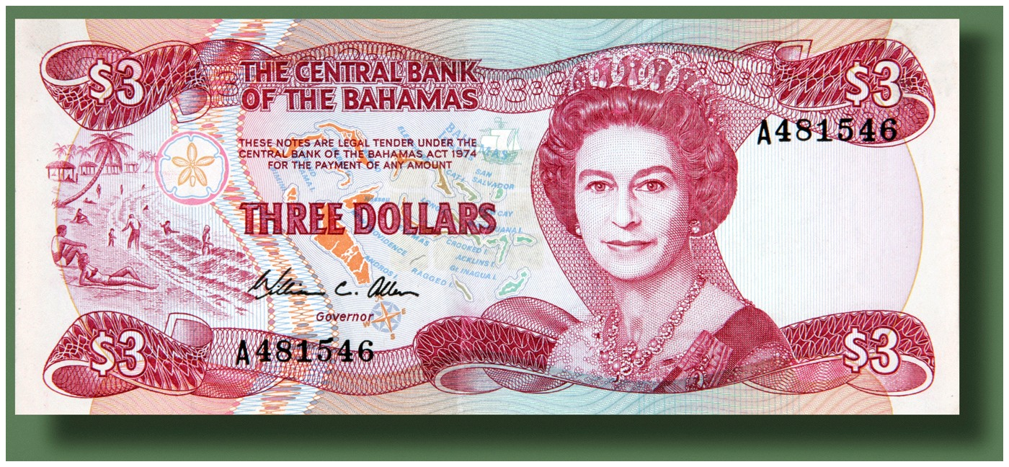
Demand for Foreign Currency—2
The price of foreign currency
  A change in the price of foreign currency
  → change in quantity demanded for the currency
  → movement along the demand curve
Demand curve for foreign currency is downward-sloping.
  Inverse relationship
  between exchange
  rate and quantity
  demanded of the
  foreign currency

Slide 17

Demand for Foreign Goods and Services
We often buy foreign goods (imports) without touching foreign currency.
Somewhere, this currency exchange is made
If there is an increase in demand for foreign goods
  We will buy more imports at any exchange rate
  Rightward shift of the demand curve for foreign currency
Notes:
Lecture notes:
Demand for foreign currency:
Depends on the demand for foreign goods
There may be an increase in demand for foreign goods because of a new product, or because a foreign country produces a better good than the United States currently does.
At some point, currency exchange occurs. For example:
A Samsung television may be produced in South Korea, but you buy it a retail store here in the United States.
The workers and factory owners in South Korea are all paid in won (the currency of South Korea).
This means that American companies that import products from overseas have to buy foreign currency (or pay the foreign company to do this) so they can pay for the imported goods.
Somebody has to buy the foreign currency to pay for the TV, even if it is not you.
For this reason, the demand for a nation’s currency depends on the demand for their exports.
Demand shift right:
If the U.S. demand for Toyota increases, then there are more reasons to buy yen, and demand for yen increases.
We buy more yen at all prices.
Demand shift left:
If the U.S. demand for Toyota decreases, then there are fewer reasons to buy yen, and demand declines.
We buy fewer yen at all prices.
Regarding the image on the slide: A Toyota
We don’t just decide “hey, I demand Japanese yen!”
We say “I need yen to buy a Japanese Toyota!”
However, we may not be directly involved in all the currency exchanges.
If more people want Toyotas, the demand for the yen will increase.

Slide 18
Demand for Foreign Financial Assets
To buy foreign stocks or bonds, need foreign currency
If interest rates in a foreign country rise (relative to the rest of the world):
  People will buy more financial assets in that country
  Demand for that country’s currency will increase (shift right)
Exchange rates and foreign interest rates are two different prices.
  United States is seen as low risk and stable.
  Foreigners demand U.S. dollars for this reason.
Notes:
Lecture notes:
To buy stocks or bonds in a foreign country, you have to convert to their local currency.
Even to establish a foreign bank account, you first buy the currency of that country.
If people from other nations want to buy U.S. stocks or bonds, they exchange their currency for U.S. dollars first.
This will increase demand for U.S. currency, since more will be demanded at any exchange rate.
A primary reason why foreigners demand U.S. dollars is to buy U.S. stocks, bonds, and real estate.
Relative to the rest of the world, the United States is often seen as a stable, low-risk economy.
This has certainly changed since the financial turmoil during and around the Great Recession.
But the long-term productivity by U.S. firms still attracts foreign funds.
For this reason, there is still a stable demand for U.S. dollars.

Slide 19
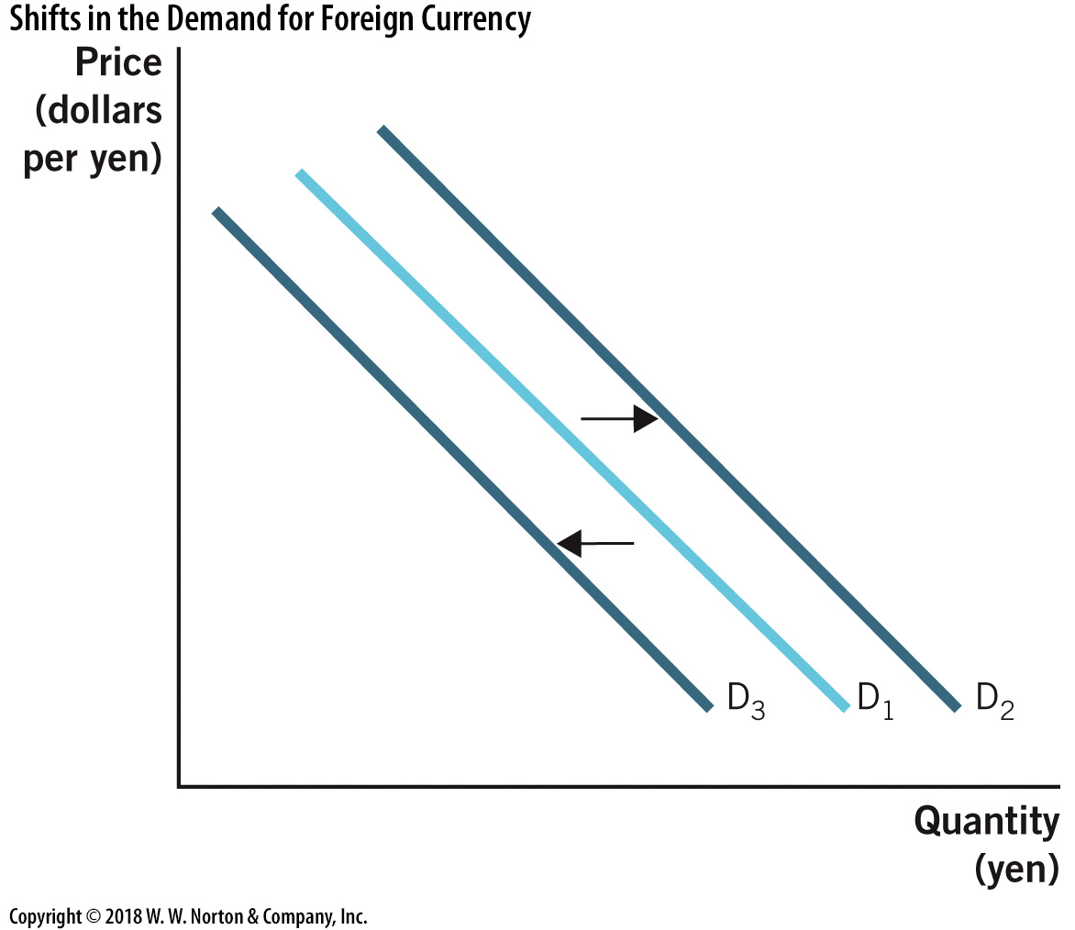
Shifts in Demand for Foreign Currency
Notes:
Image: Figure 20.3
Lecture notes:
Increases in demand for foreign currency derive from:
An increase in demand for foreign goods and services.
An increase in demand for foreign financial assets.
Decreases in demand for foreign currency derive from:
A decrease in demand for foreign goods and services.
A decrease in demand for foreign financial assets.

Slide 20
Practice What You Know—2
What will cause an increase in demand (rightward shift) for foreign currency?
  an increase in demand for foreign goods
  an increase in the exchange rate
  a decrease in the exchange rate
  a decrease in the demand for U.S. products
Notes:
Clicker question:
Correct answer: A, an increase in demand for foreign goods
If we want more foreign goods for some reason (causing us to have a rightward shift in demand for those products), we’ll buy more foreign currency at all exchange rates (the shift in the demand for the currency).
Answers [b] and [c] consider movements along the demand curve for foreign currency, rather than shifts.

Slide 21
Supply of Foreign Currency
The government controls the money supply.
From a market standpoint, there is a fixed amount of fiat currency at any one time.
  Vertical supply curve
  Curve can shift with increases or decreases in the money supply
Notes:
Lecture tip:
Remind students that currency is money.
Fiat currency is printed and supplied by governments.
From a market standpoint, it is fixed in quantity at any one time.
Governments increase and decrease the supply of currency very often, and when they do, this shifts the supply curve.

Slide 22
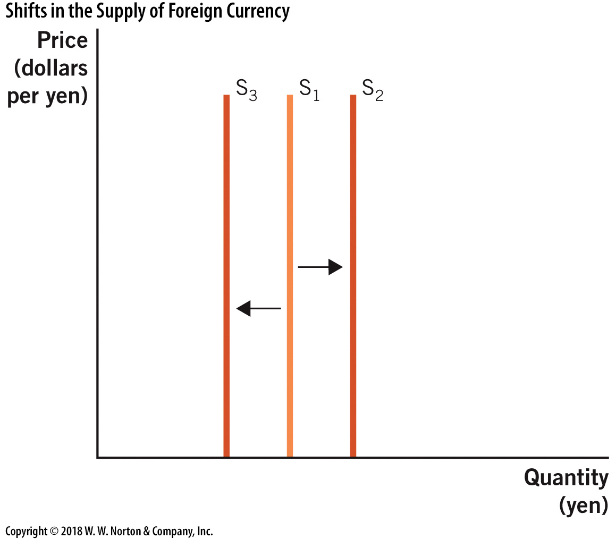
Shifts in the Supply of Foreign Currency
Notes:
Image: Figure 20.4
Lecture notes:
Since currency is generally fiat currency, the supply of foreign currency is determined by the government of the foreign nation.
For example: The European Central Bank (ECB) increases and decreases the quantity of euros in world markets.

Slide 23
Changes in Demand of Foreign Currency—1
Notes:
Image: Animated Figure 20.5
Lecture tip:
Click through the slide to reveal each part of the graph.
Lecture notes:
An increase in the demand for foreign currency leads to an increase in the exchange rate from $0.010 to $0.012.
This signals a depreciation of the U.S. dollar relative to the yen.
A decrease in the demand for foreign currency leads to a decrease in the exchange rate from $0.010 to $0.008.
This signals an appreciation of the U.S. dollar relative to the yen.

Slide 24
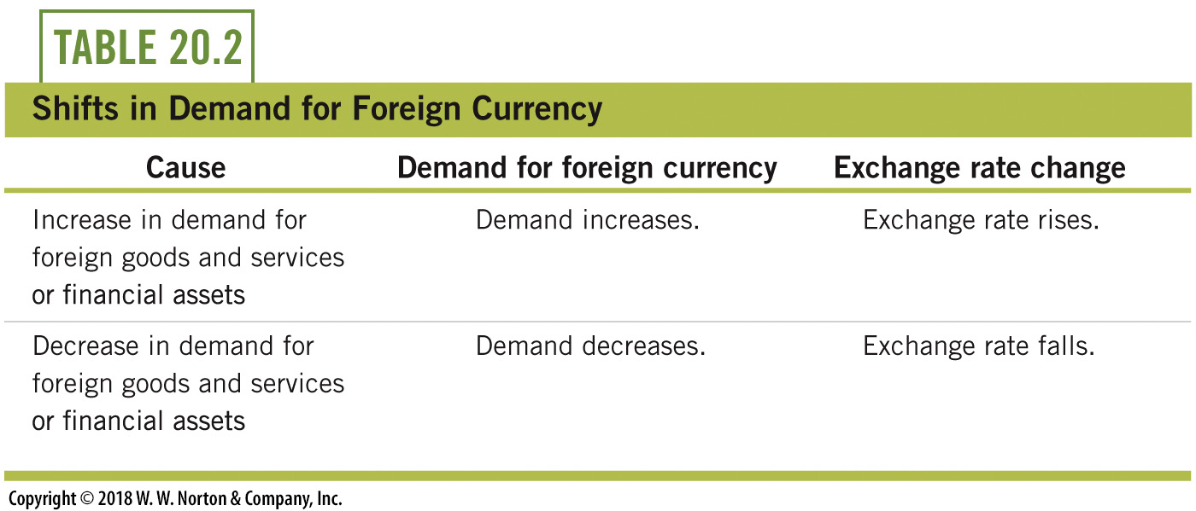
Changes in Demand of Foreign Currency—2
Changes in demand for foreign currency “naturally” occur with demand changes for imports and foreign financial assets
Notes:
Lecture tip:
Present this simple example:
Suppose consumer preferences in the United States shift away from Hondas and toward Volkswagens.
The demand for Japanese yen declines, and demand for the euro rises.
These demand shifts can occur “naturally,” just as a result of changing preferences.

Slide 25
Changes in Supply—1
Notes:
Image: Animated Figure 20.6
Lecture tip:
Click through the slide to reveal each part of the graph.
Lecture notes:
Changes in supply are more “unnatural,” as they result solely from actions of governments.
The figure on the slide shows an increase in the supply of a foreign currency, the yen.
All else being equal, an increase in the quantity of yen shifts the supply of yen outward.
This change decreases the exchange rate, depreciating the yen and appreciating the dollar.
This increase in supply could be done with the intention of exchange rate manipulation.

Slide 26
Changes in Supply—2
Exchange rate manipulation
  National governments intentionally adjust their money supply to affect their exchange rate.
Why devalue your own currency?
  Lowering the exchange rates makes your exports more attractive and affordable
  → short-run effect on aggregate demand
Notes:
Lecture notes:
Changes in supply:
More “unnatural,” as they result from actions of governments
Nations purposefully depreciate their own currency in order to make their exports more affordable to buyers around the world.
If euros fall in value, each dollar buys more euros and then Volkswagens become more affordable.
All else being equal, this leads to a greater quantity demanded of Volkswagens in the United States.
Therefore, currency devaluation, through increasing the quantity of currency, can certainly have a short-run impact on aggregate demand.
AD increases because net exports will increase.

Slide 27
Increase in Japan AD from
Yen Depreciation
Notes:
Image: Animated Figure 20.7
Lecture tip:
Click through the slide to reveal each part of the graph.
Lecture notes:
If Japan acts to depreciate the yen, this increases aggregate demand for Japanese goods and services, including those produced in Japan.
In the short run, this increases real GDP and decreases unemployment (not pictured here), due to some sticky prices.
This is just another dimension of expansionary monetary policy.
When a central bank increases its money supply, it reduces the exchange rate and increases AD in the short run.
In the long run, when prices adjust fully, there are no real effects.
Recall:
Why does the SRAS shift back left to the new equilibrium that intersects the LRAS?
Remember the difference between the long run and the short run: in the long run, all prices adjust.
As all prices adjust, the short-run aggregate supply curve shifts upward from SRAS₁ to SRAS₂.
Notice that now we are back to the original output level (Y*), but prices are higher.
The model is telling us that demand changes have no real effects in the long run, as the effects are only on the price level, a nominal variable.

Slide 28
Practice What You Know—3
Suppose that the U.S. dollar appreciates compared to the Japanese yen. What will happen as a result?
  The exchange rate of yens to dollars will not change.
  It will take less yen to buy a U.S. dollar.
  It will take more U.S. dollars to buy yen.
  Japanese goods will become more attractive to American consumers.
Notes:
Clicker question:
Correct answer: D, Japanese goods will become more attractive to American consumers.
If the dollar appreciates compared to the yen, it means that yen are now cheaper to buy.
We can get yens cheaper, which makes Japanese goods more attractive since we can effectively use fewer dollars to purchase the Japanese goods (by getting more yens for our dollar).

Slide 29
Practice What You Know—4
Why would a country devalue its own currency?
  to become more dependent on other countries’ imports
  to retaliate against countries with overvalued currency
  to make its exports more attractive to foreign countries
  to decrease the price of imports it purchases from other countries
Notes:
Clicker question:
Correct answer: C, to make its exports more attractive to foreign countries
If a country keeps its currency undervalued, goods from that country will be cheaper and more attractive to foreigners.
This can help a country get a trading relationship started with other countries, and can boost the country’s exports significantly.

Slide 30
Pegging Exchange Rates
Pegged exchange rates
  Exchange rates that are fixed at a certain level through the actions of a government
Flexible (floating) exchange rates
  Exchange rates determined by the market forces of supply and demand
Notes:
Lecture tip:
You can tell students to think of a pegged exchange rate as a price control on your currency.
The government acts to keep the price of their currency at a desired level.

Slide 31
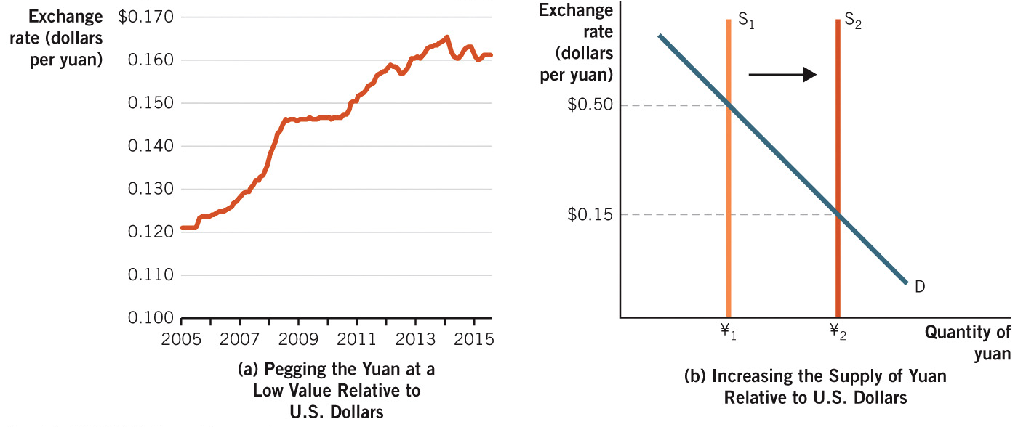
How China Pegs the Yuan
Notes:
Image: Figure 20.8
Lecture notes:
The yuan is pegged to the dollar. This just means its value is controlled by the Chinese government.
For example, from mid-2008 until mid-2010, the peg was set at $0.147; after this, it was allowed to rise.
The exchange rate is pegged below market values with the goal of keeping Chinese exports inexpensive on world markets.
To keep the exchange rate below the natural market rate, the government has to buy U.S. dollars and other U.S. assets in world markets.
They use yuan to make these purchases so this is essentially increasing the supply of yuan, shifting the supply curve to the right.

Slide 32
Pegging Exchange Rates:
The Chinese Yuan
The Chinese yuan has been pegged at a value below the market value.
  Increasing the yuan supply relative to the supply of US $
  The Chinese government buys U.S. dollars (and later Treasury securities) with newly minted yuan
  → Demand for the yuan increases
  → Decreases the exchange rate
Results:
  Chinese goods are cheap
  Chinese workers paid with less valuable currency
Notes:
Lecture notes:
The Yuan:
China uses many freshly minted yuan to buy U.S. Treasury bills.
The huge increase in the supply of yuan due to increased minting depreciates the yuan.
In a sense, China is conducting open market operations by buying U.S. Treasury securities and doing their own version of expansionary monetary policy.
This keeps exchange rates low, and makes Chinese goods more attractive for Americans who have dollars.
Think about how this peg affects the Chinese economy.
On the one hand, it is clear that the Chinese economy has been growing at historically large rates over the past two decades.
Many people feel that this is “cheating” to gain an international advantage.
This “cheating” can hurt certain sectors in other nations that can’t compete with artificially low prices.
China’s growth seems to indicate that this devaluation strategy is helping their economy overall, not just the export sector.
Perhaps this is true, but many other changes have taken place in China over the past two decades.
Institutional changes (the introduction of private property rights) have completely changed production incentives in China.
So, it is incomplete to pin their success on currency devaluation alone.
In addition, Chinese workers get paid in yuan.
When the government devalues the currency, this effectively gives the workers a real pay cut.
Part of the reason why Chinese exports are so cheap is that labor costs are very low.
But this is not a positive situation for the actual laborers.

Slide 33
Purchasing Power Parity
The law of one price
  After accounting for transportation costs and trade barriers, identical goods sold in different locations must sell for the same price.
  Price in location A = Price in location B
Dynamics (using oranges as an example)
  Suppose oranges are selling for a higher price in Michigan than Florida.
  Suppliers will decrease their supplies in Florida and increase their supplies in Michigan.
  These supply changes will occur until the prices are equal.

Slide 34
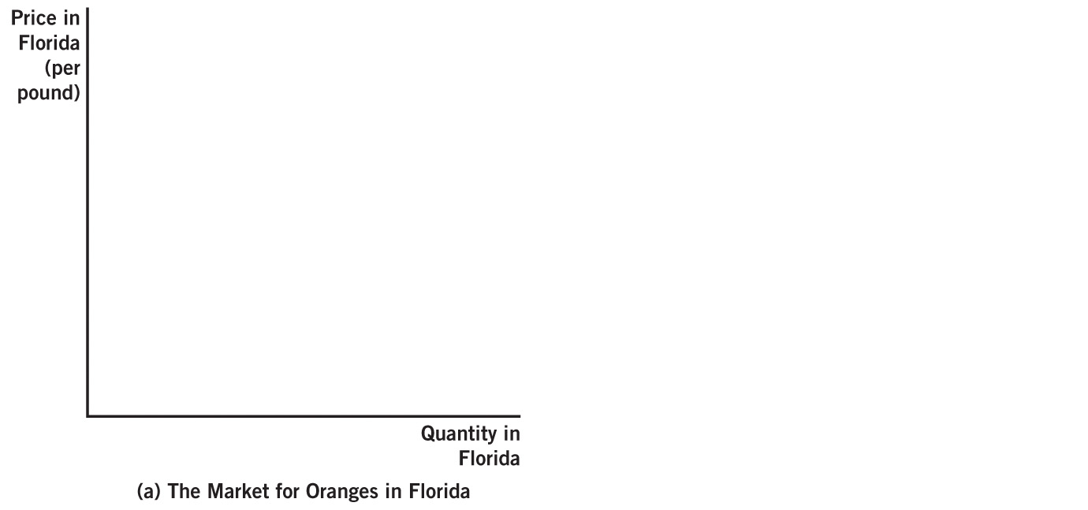
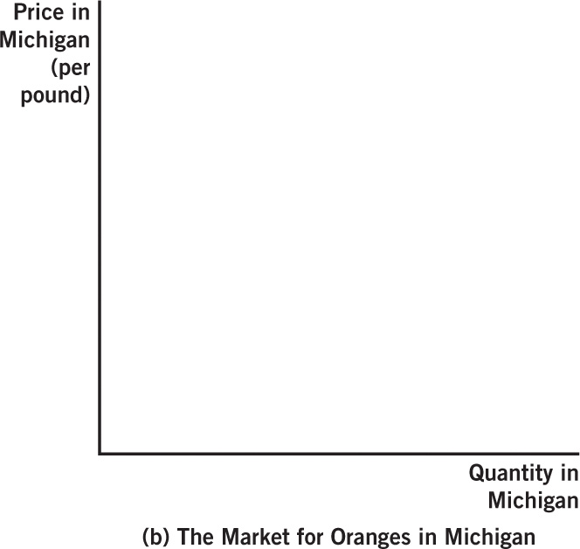
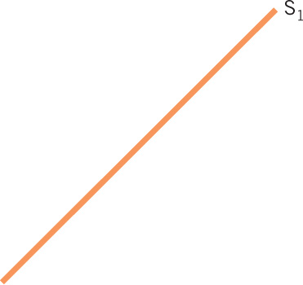
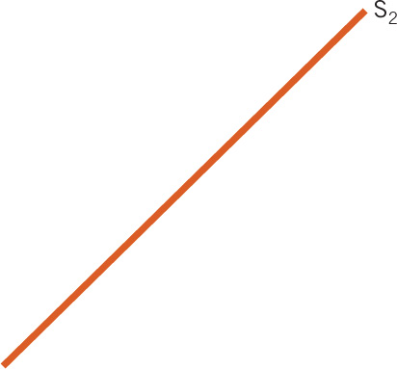
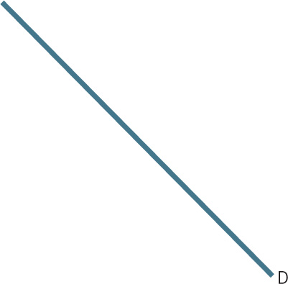
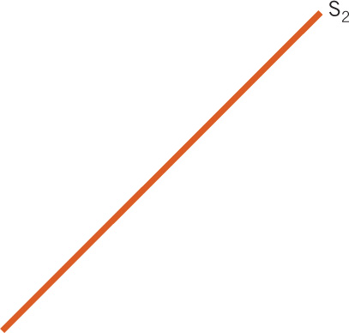
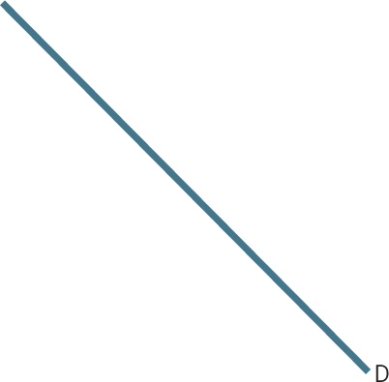
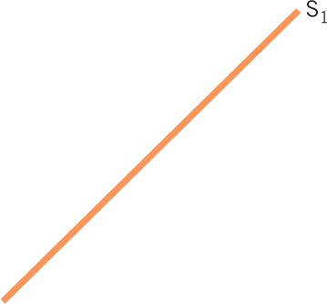
Law of One Price
Notes:
Image: Animated Figure 20.9
Lecture tip:
Click through the slide to reveal each part of the graphs.
Lecture notes:
Panel (a):
Initially, the price of a pound of oranges in Florida is $1.80
Panel (b):
The same oranges sell for $2.20 per pound in Michigan.
Thus, orange suppliers reduce supply in Florida and increase supply in Michigan.
If transportation costs are zero, these supply changes will take place until the price is the same in both locations.

Slide 35
Purchasing Power Parity and Exchange Rates—1
Purchasing power parity (PPP)
  A unit of currency should be able to buy the same quantity of goods and services in any country
  Recall that we must consider exchange rates when buying goods in a foreign country.
Example of PPP holding true:
  Pineapples are priced at $1.50 in the United States.
  Exchange rate: One U.S. $ can buy 100 Japanese yen
  Pineapples are priced at 150 yen in Japan.

Slide 36


Purchasing Power Parity and Exchange Rates—2
For any good at locations A and B, purchasing power parity will hold if:
Worldwide PPP would hold if the equation is true for any two countries.
Notes:
Lecture tip:
Encourage students to intuitively think of it like this: Imagine you were going to buy a good in the United States with exact change.
You could take that exact change and convert it to the foreign currency.
In the foreign country, you would have exact change for the good as well.
You wouldn’t have to get any extra currency and would not receive change after purchasing the good.
Regarding the image on the slide:
A popular application of PPP is the “Big Mac Index” (see in a few slides).
The Big Mac is a good sold in many countries, so we can measure prices of the Big Mac and exchange rates across countries to see if PPP holds.

Slide 37
Why PPP Does Not
Hold Perfectly
Reasons why PPP may not hold in the short run:
  Goods and services must be identical
    Brand names may mean different things in different countries
  Some services are not tradeable.
    You can’t import or export haircuts or tattoos
  Trade barriers (quotas and tariffs) may inhibit trade
  Shipping costs
  Some prices take longer to adjust
Notes:
Lecture notes:
Examples for each of the points on the slide:
In India, a Big Mac is a chicken sandwich.
If you want a German haircut, travel to Germany.
The higher the trade barriers are, the higher the price of the foreign good will be.
Shipping costs prevent prices from completely equalizing.
The PPP theory is a long-run theory, and some prices are stickier in the short run.

Slide 38

Economics in EuroTrip
EuroTrip, 2004
  In this scene, four college-age friends get stranded in an eastern European country.
  Thankfully, PPP does not hold.
  Obviously, the scene is exaggerated…
Notes:
”Economics in the Media” Slide
Lecture tip:
The clip mentioned on the slide can be found in the Interactive Instructor’s Guide. Access the direct link by clicking the icon in the PowerPoint above.

Slide 39
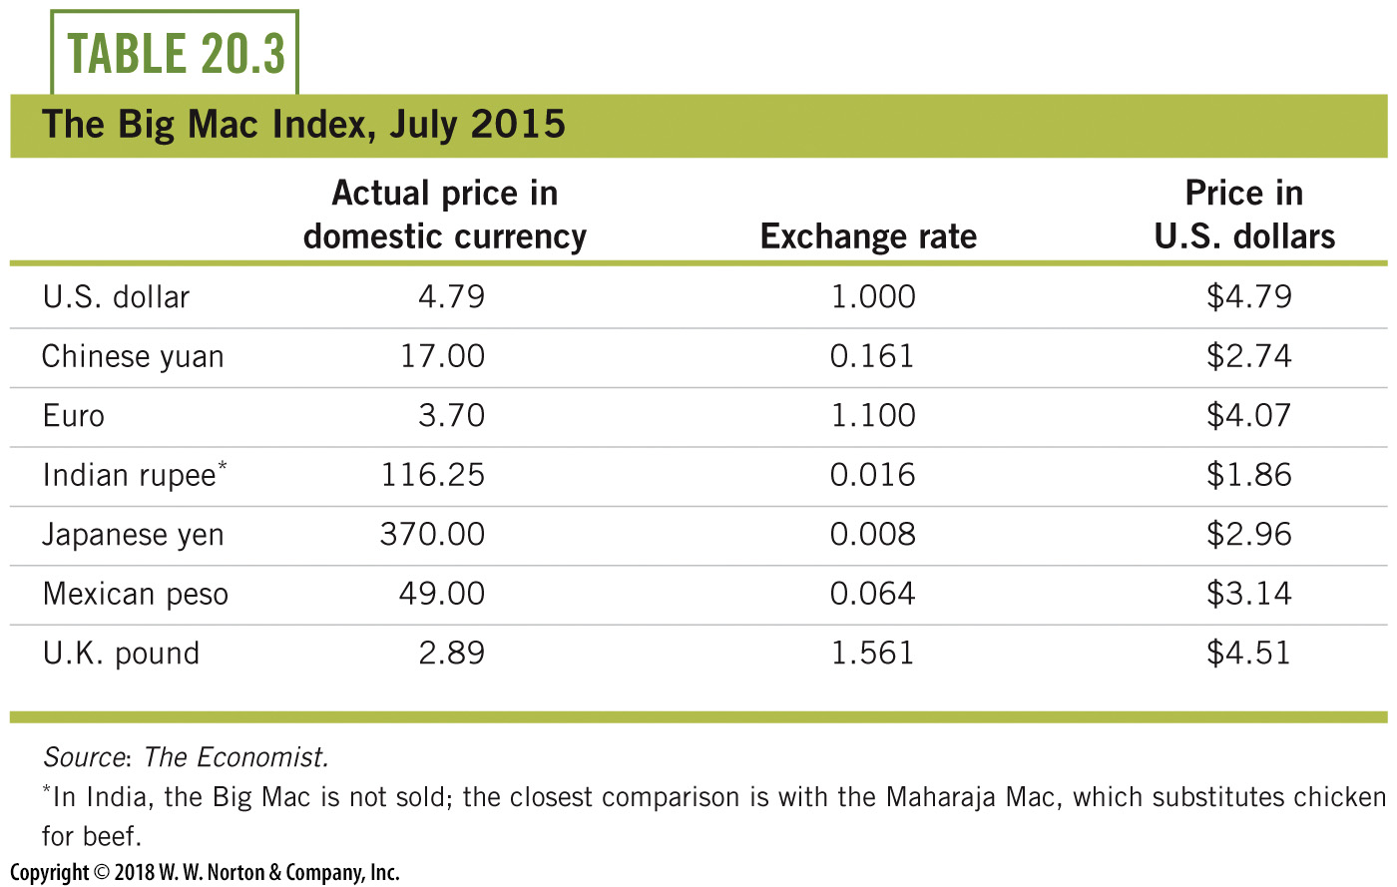
The Big Mac Index
Notes:
Lecture notes:
We have said that purchasing power parity is a condition that should hold in the long run.
The Economist magazine has devised a creative way to test PPP at any given point in time.
It compares the price of a McDonald’s Big Mac sandwich across many nations.
The Big Mac is a good choice because it is roughly the same good all over the world.
If PPP held perfectly, the prices in the last column would all be $4.79—the price of a Big Mac in the United States.
The Big Mac Index is an intuitive illustration of PPP.
It also helps us see which currencies are valued close to their long-run equilibrium levels relative to the dollar.
For example, the euro and the Turkish lira are all very close to the level implied by PPP.
But some prices are off significantly, for example, PPP implies a Big Mac price of 299 rupees in India, but the actual price is just 116.25 rupees.
Price_India X 0.016=$4.79
Price_India=$4.79/0.016
There is a good reason for this discrepancy: the Indian version of the Big Mac, called the Maharaja Mac, substitutes chicken patties for the customary beef patties.

Slide 40
What Causes Trade Deficits?
Trade deficit: imports > exports
This is not necessarily bad for a few reasons:
  Increased imports may be a sign of higher wealth
  Able to afford to purchase more imports
  Trade creates value
Notes:
Lecture notes:
In fact, trade deficits often increase during economic growth.
Deficits don’t necessarily mean that we’re worse off.
Lecture tip:
You can discuss this restaurant example to show students that deficits aren’t necessarily bad:
Think about your favorite place to eat lunch near your campus; perhaps you go there once a week.
The fact is, you have a trade deficit with that restaurant (unless you also happen to work there).
You buy more from them than they buy from you.
Does this make you worse off or indicate weakness on your part? No.
In fact, the wealthier you are, the more you may eat at your favorite restaurant, but then your trade deficit with them increases.
If voluntary trade creates a trade deficit for you, it doesn’t mean you are worse off.
Remember: trade creates value.

Slide 41
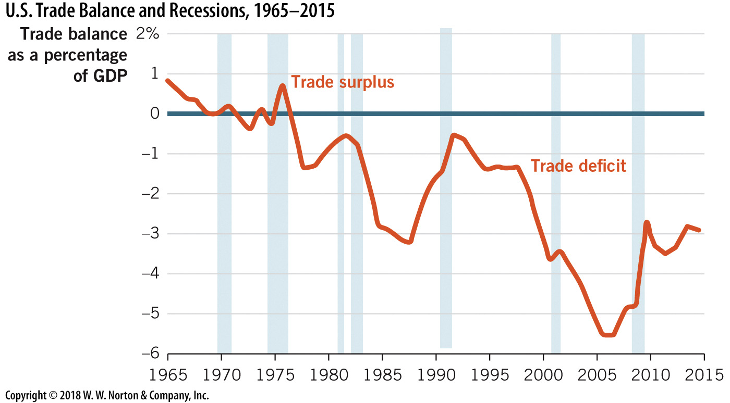
U.S. Trade Balance and Recessions
Notes:
Image: Figure 20.10
Lecture notes:
The figure on the slide shows the U.S. trade balance (exports – imports) with recession periods shaded.
Since 1975, there has been a trade deficit in the United States, peaking in 2006.
Notice that the trade deficit widens during periods of expansion and then shrinks during recessions.
From this perspective, trade deficits seem to be a byproduct of positive economic time periods.

Slide 42

Balance of Payments
Balance of payments (BOP)
  Record of payments between a country and the rest of the world
  A method to track payments made across borders
Current account
  Goods, services, current income, gifts
  Often in a deficit (inflows > outflows)
Capital account
  Real and financial assets, financial derivatives
  Often in a surplus (outflows > inflows)
Notes:
Lecture notes:
Some examples:
If you buy a car made in Japan, the dollar amount of that transaction is recorded in the balance of payments.
If someone from Canada buys shares of stock in a U.S. corporation, that payment is also tracked in the U.S. balance of payments (and Canada’s too).
These are just two of many possible examples.
Any time a payment is made across borders, the payment is tracked in the BOP.
Account deficit:
An account deficit means that more payments are flowing out of the account than into it.
Imported toys would cause a current account deficit.
Account surplus:
An account surplus means that more payments are flowing into the account than out of it.
Capital account:
Capital account tracks payments for real and financial assets between nations:
Stocks and bonds
Currency trades
Real estate
The U.S. Bureau of Economic Analysis refers to the capital account as the financial account.
Lecture tip:
Here are some other examples you could discuss with students:
When the Chinese government buys U.S. Treasury securities, this transaction is recorded in the capital account.
This would be an inflow, because funds are flowing in from China.
If an American deposits funds into a Swiss bank account, this transaction is recorded in the capital account.
This would be an outflow, because funds are flowing from the United States to another country.
Purchases of real assets also enter in the capital account.
If you bought a vacation home in Cozumel, Mexico, this counts as an outgoing payment in the capital account.
When the Abu Dhabi Investment Council purchased the Chrysler Building in New York City, this transaction was recorded in the capital account as an incoming payment.

Slide 43
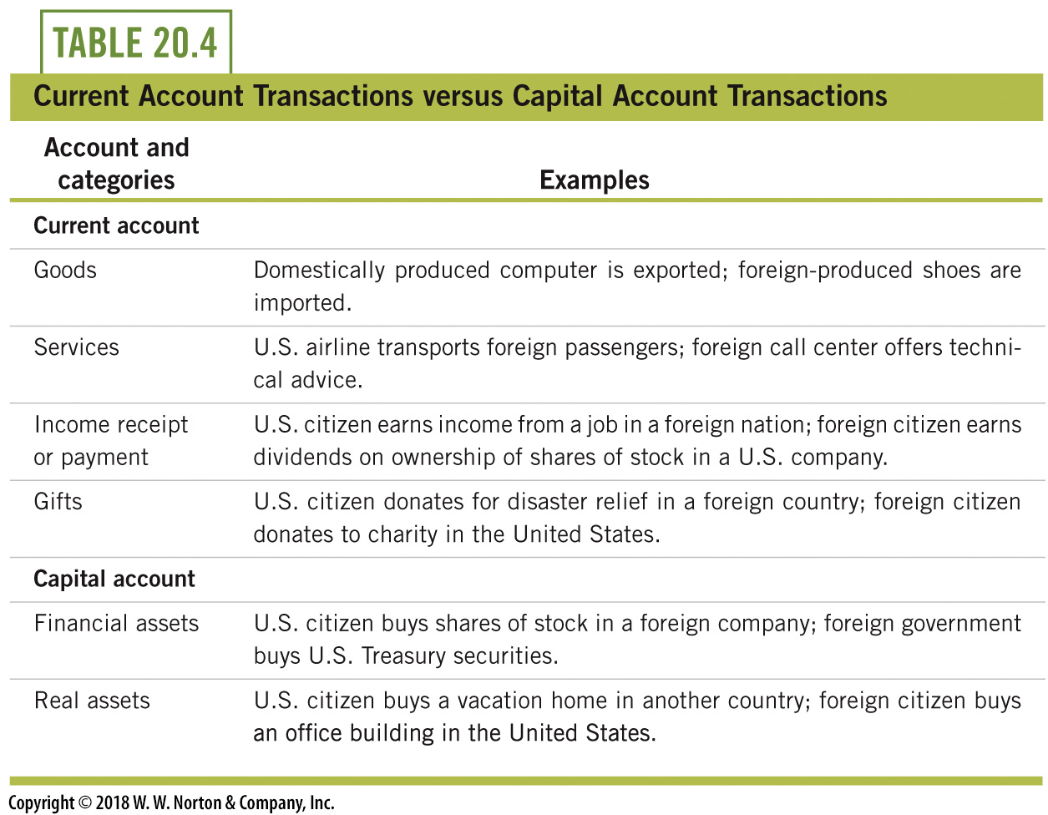
Current Account and
Capital Account Transactions
Notes:
Lecture notes:
The table shows the major categories of both the current and the capital accounts, along with some examples of the types of transactions entered in each.
Real-world example: Current Account Balance
This could be a good time to present the real-world example on current account balance from the Interactive Instructor’s Guide (See Tip #686).
Every quarter, the Bureau of Economic Analysis (BEA), along with the Commerce Department, publishes a report on the accounting of U.S. trade and investment with the rest of the world.
The BEA relates these data on its web site (cited below) 2.5 months after the quarter ends.
http://bea.gov/newsreleases/international/transactions/transnewsrelease.htm
We learn in this chapter that trade deficits are essentially synonymous with current account deficits, and economic growth increases current account deficits.
Having students pay attention to economic indicators can give them a sense of what is going on in the real-world economy.

Slide 44
Current Account and
Capital Account
“Trade deficit” often refers to a current account deficit.
  Occurs when more payments flow out of the account than into the account
  With current account deficits, imports > exports
Account surplus:
  Exists when more payments are made into the account than out of the account
  Caused by a trade surplus
Notes:
Lecture notes:
Generally, this means we are importing more goods and services than we are exporting.
The U.S. current account deficit in 2014 was $389,571,000,000 (almost $390 billion).

Slide 45
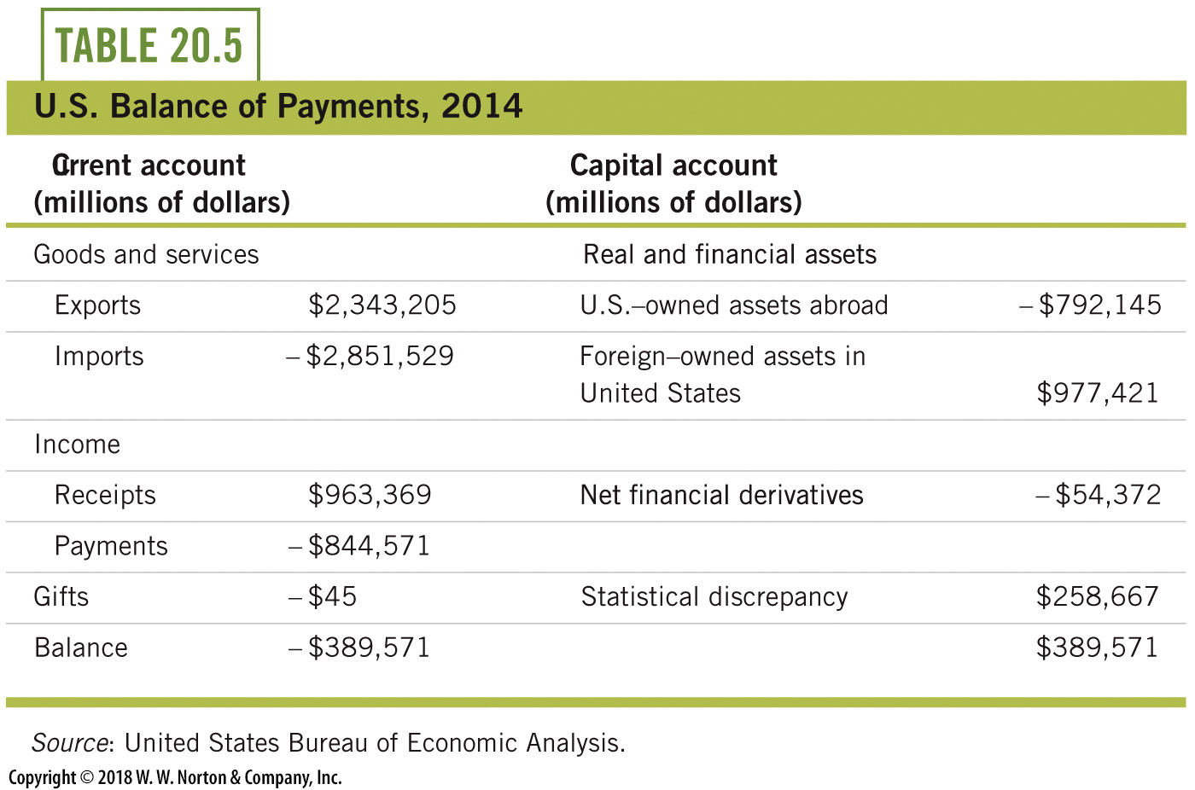
U.S. Balance of Payments (Millions of Dollars)
Notes:
Lecture notes:
The table on the slide shows that the U.S. current account deficit in 2014 was almost $390 billion.

Slide 46
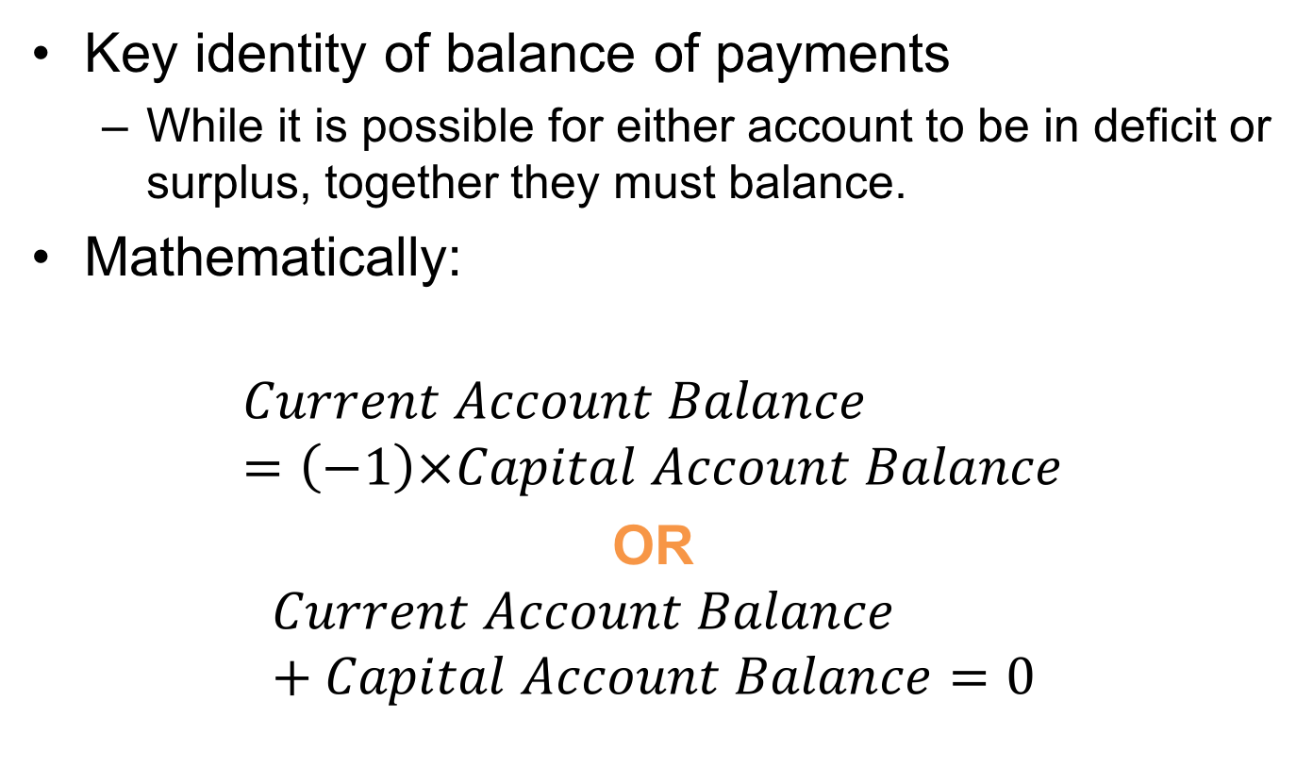
The Key Identity of Balance of Payments
Key identity of balance of payments
  While it is possible for either account to be in deficit or surplus, together they must balance.
Mathematically:
$$Current Account Balance=\left(−1\right)×Capital Account Balance$$
OR
$$Current Account Balance+Capital Account Balance=0$$
Notes:
Lecture tip:
This illustrates why it’s called the “balance” of payments.
The two numbers will equal each other in absolute value.
We continue on with some mathematical examples to “prove” this.

Slide 47
The Key Identity of Balance of Payments: Example
Assume trade deficit begins at zero
  Imports=exports
Capital account is balanced also
  U.S. ownership of foreign assets=foreign ownership of U.S. assets
Now, suppose you buy a $40,000 Japanese car.
  Imports exceed exports by $40,000.
  → current account deficit of this amount
  You exchanged $40,000 (U.S. financial asset) for the car.
  → capital account surplus of $40,000
Notes:
Lecture notes:
In other words, start with: Current account = 0 = Capital account
Japanese car is purchased: Current account + Capital account = 0
-$40,000 + $40,000 = 0

Slide 48
The Key Identity of Balance of Payments: Extended Example
Extension 1: Japan uses the $40,000 to buy John Deere tractors made in the United States
  $40,000 worth of U.S. exports
  Current account deficit and capital account surplus disappear
Extension 2: Japan uses the $40,000 to purchase shares of John Deere stock
  Current account and capital account balances stay the same
  Japan just shifted to a different U.S. financial asset (stock instead of currency)
Notes:
Lecture notes:
Extension 1:
In this case, the current account would increase by $40,000 since $40,000 of exports are now generated.
The current account is now at a zero balance.
The capital account decreases by $40,000 and is now at a zero balance.
It decreased by $40,000 because we now have $40,000 less worth of financial assets (the stock is now owned by Japan).
For both extensions, start where we were after the car was purchased.
Current account = -$40,000
Capital account = $40,000
Sum = 0

Slide 49
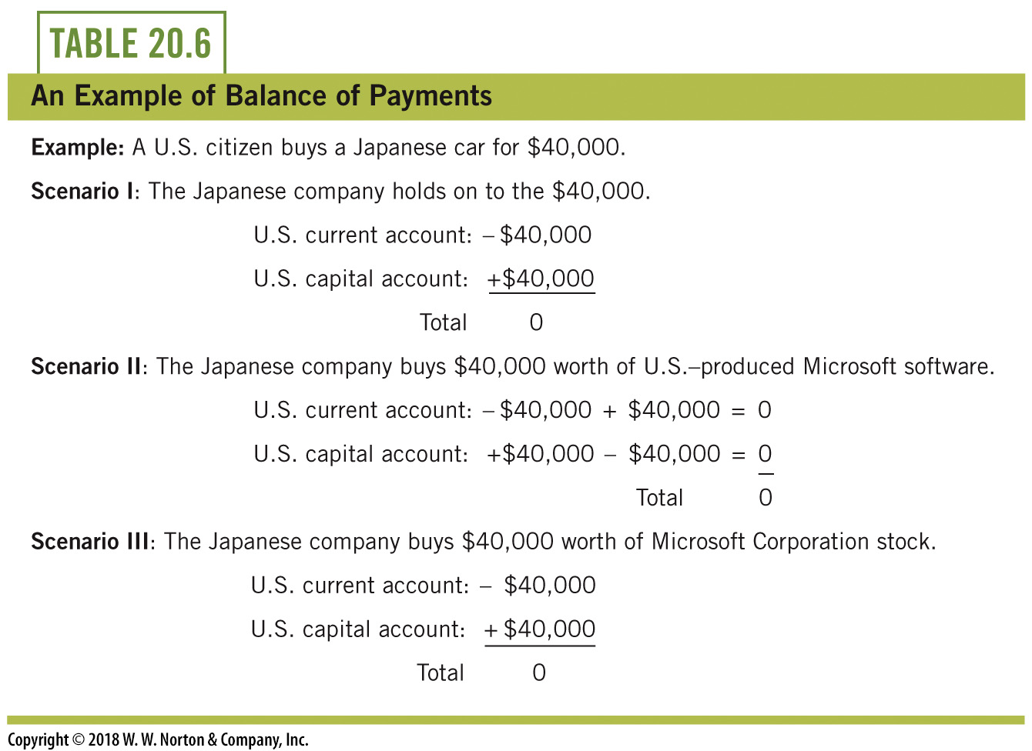
Balance of Payments: Another Example
Notes:
Lecture notes:
In all three cases presented in the table, we start off by assuming the U.S. citizen buys the Japanese car for $40,000.
The three different scenarios show the Japanese company doing different things with the $40,000 it receives from the American.
In all cases, the current account changes are offset by opposite capital account changes.

Slide 50
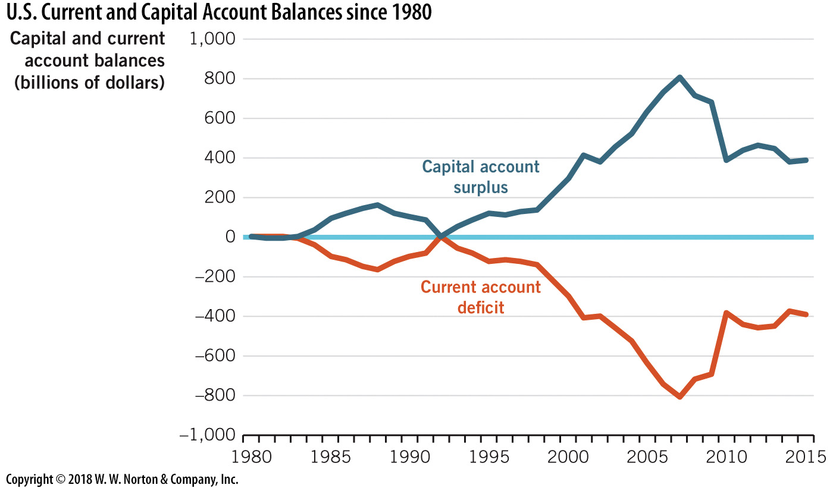
U.S. Current and Capital Account Balances
Notes:
Image: Figure 20.11
Lecture notes
The graph on the slide reflects our balance of payments identity since the current account and the capital account are essentially mirror images of one another.
If we say we have a current account deficit, we are also saying we have a capital account surplus.

Slide 51
Causes of Trade Deficits
A trade deficit means a current account deficit. There are two ways that trade deficits increase:
  Increases in the current account deficit
  Increases in the capital account surplus
Causes of these scenarios
  Strong economic growth
  Lower personal saving
  Fiscal policy
Notes:
Lecture tip:
Ask students to recall:
GDP is the sum of four components:
Y = C + I + G + NX.
The fourth piece is net exports.
All else being equal, net exports fall when a nation imports more goods.
In this sense, the greater current account deficit implies lower GDP.
This point alone seems sufficient to prove that nations are better off with fewer imports and/or more exports.
We caution you against jumping immediately to this conclusion.
Trade deficits are not always a sign of economic problems.

Slide 52
Strong Economic Growth
Current account deficits
  Wealthy consumers can afford more imports
  Imports increase at a faster rate than exports
  → current account deficit appears
Capital account surplus
  Growing economies offer higher returns on investment
  Demand for loanable funds increases
  Funds flow in from around the world
  → capital account surplus
Notes:
Lecture notes:
Consider Bill Gates’ personal account:
Bill Gates has personal trade deficits all over the world simply because he buys large quantities of goods and services.
This also applies to nations. Wealthy nations with strong economies often buy large quantities of imports from other countries.
Higher wealth means we can afford to buy more goods; that itself is not a bad thing, even though it will lead to a current account deficit.
When an economy is growing rapidly, relative to the rest of the world, the firms in that economy are willing to pay more for investment funds (the demand for loanable funds shifts out).
This leads to higher interest rates in the growing economy and then international funds flow in to take advantage of these.

Slide 53
Practice What You Know—5
If U.S. exports increase:
  the current and capital account will no longer balance.
  current account deficits will shrink.
  current account deficits will increase.
  the demand for loanable funds will decrease.
Notes:
Clicker question:
Correct answer: B, current account deficits will shrink.
With exports, funds will come into the country.
The current account is goods, services, current income, and gifts.
More funds will enter this account than before; the deficit in this account will shrink, and the surplus in the capital account will shrink as well.

Slide 54
Lower Personal Saving
When individuals and governments save, this saving can be used for investment.
If domestic savings falls, investment must be funded with outside sources.
  This financing comes from savers in foreign countries.
  Bringing this investment into the United States increases the capital account surplus.
Notes:
Lecture notes:
In the United States, personal savings rates have dropped significantly since the early 1990s.
So, while the U.S. economy was growing throughout the 1990s and into the first decade of this century, the necessary financing was coming from savers around the globe.
This increases the capital account surplus, which implies an increase in the current account deficit.
The influx of funds from around the globe increased the supply of loanable funds, and was instrumental in keeping U.S. interest rates low and allowing firms to fund expansion.
These funds were critical as U.S. savings rates fell, but they did contribute to the widening current account deficit.

Slide 55
Fiscal Policy
Budget deficits also contribute to current account deficits.
  These deficits consume domestic funds.
  The government is using funds that could have been used for private investment (crowding out).
  International funds also fund the deficit, which increases the capital account surplus.
Notes:
Lecture tip:
Remind students of this important principle: Every dollar borrowed requires a dollar saved.
So, when the U.S. government borrows trillions each year in order to spend, this is similar to a further reduction in personal savings in the sense that the borrowing is paid for by foreign investors.

Slide 56
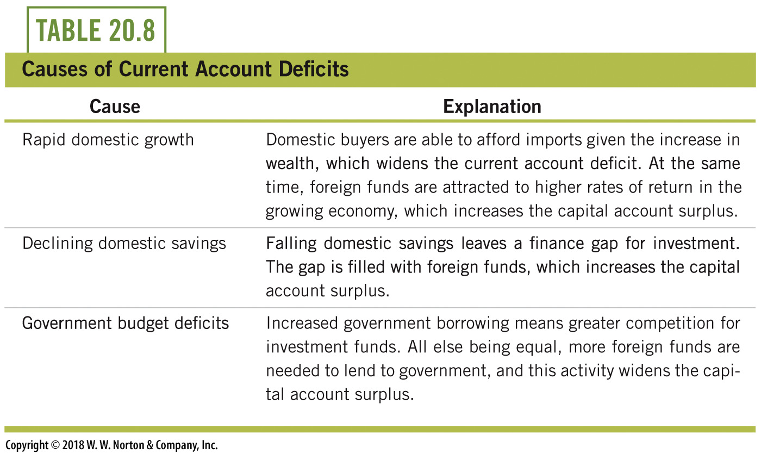
Causes of Current Account Deficits
Notes:
Lecture notes:
The bottom line is that many factors cause trade deficits, some that don’t even seem related to goods and services.
The past few decades of U.S. experience offer examples of all three.
The 1980s were times of large budget deficits and the trade deficit widened.
Beginning around 1990, personal savings rates fell and the economy grew rapidly so that the trade deficit widened even as the federal government balanced its budget.
Finally, a recent return to historically large budget deficits has added to the pressure for capital inflows, reducing any prospects for elimination of the trade deficit any time soon.

Slide 57
Conclusion
Exchange rates and trade deficits are economic indicators, but are often misunderstood
Exchange rates are prices for foreign currency
  Can sometimes be manipulated by governments
Trade deficits have simple intuition, but the causes are not always straightforward
Trade deficits are not necessarily a bad sign for the economy

